Slide 1

ASHOK GUPTA-9555439900

Slide 2





















Slide 3











Slide 4
12 Types of Income Plan
1. Retail Profit: 20%-40%-50%
Performance Bonus: 6%
Active Bonus: 25%
Consistency Bonus: 7%
Business Building Fund Bonus: 7%
Super Active Bonus: 15%
Car Fund Bonus: 7.5%
House Fund Bonus: 5%
(A) Distribution in 1st & 2nd Org. Business: 72.5%
1st & 2nd Organisation
Flagship Bonus: 6%
Super Flagship Bonus: 5%
Mega Flagship Bonus: 5%
(B) Distribution in 3rd & 4th Org. Business: 16%
3rd & 4th Organisation
12. Corona Relief Fund: 11.5%
TOTAL DISTRIBUTION : A+B+11.5 (CRF)=100%

Slide 5
You
2nd Org 3rd Org
1st Org
4th Org

Slide 6



1.Retail Profit:
Face Wash: MRP 130/- D.P 90/- Retail Profit: 40/- Profit %: Upto 20%-40%-50%
MRP: 1800. DP: 1260. BV 630.
Suppose Monthly 1 lakh Sale Done. If 15% margin than 15000/- cash in hand.

Slide 7

Consistency & Super Consistency
First Offer:
Buy 2000dp Products continuously for 6 months & get 2000 MRP products free of cost in 7th month. Last Date is 15th of Every month.
Second Offer:
Buy 5000dp Products continuously for 6 months & get 10000 MRP products free of cost in 7th month. Last Date is 15th of Every month.
T&C Apply:
This offer is applicable on single invoice only.
Products must be from Consistency & Super Consistency Product List. This offer is non-Transferrable.

Slide 8



2. Performance Bonus:6%
1 BV=2.5 Rs To 4 Rs. Lets Assume 1BV- 3Rs 2BV- 6Rs 3BV- 9Rs
1 BV - 2500BV :3%
2501BV- 4999BV :4%
5000BV & Above :6%
YOU 1000BV
₁st
500BV
₂nd
1500BV
CALCULATION:
Total Business of YOU= 1000BV+500BV+1500BV=3000BV (4%)
4% of 1000BV= 40/-
Income from 1St Org: 4%(YOU) - 3%(1ST)=1%, now 1% of 500BV=5/- Income from 2nd Org: 4%(YOU) - 3%(2ND)=1% now 1% of 1500BV=15/-
TOTAL INCOME IN RS: 40+5+15=60/-

Slide 9



3. Active Bonus: 25%
YOU
₁ST
Org.
₂nd
Org.
2500BV
5000BV
10,000BV
2500BV. = 1 Point or 1ABP =200/- (175-200)
5000BV = 2 Point = 400/-
10,000BV = 4 Point = 800/-
ACTIVE BONUS CAPPING: 90,000/- Rs.

Slide 10




4. Consistency Bonus: 7%
YOU
₁ST
Org.
₂nd
Org.
2500BV
2500BV
2500BV
2500BV – MAY
2500BV– JUNE
2500BV – JULY
If 3 months Continuously min 2500BV done both sides then from 4th month
i.e Aug, Consistency Bonus will Start.
1 CBP = 60-70/-
CONSISTENCY BONUS CAPPING: 45000/-

Slide 11



5. Business Building Fund Bonus: 7%
YOU
₁ST
Org.
₂nd
Org.
25000BV 25000BV = 1 Point=1BBF point=4500/- to 5200/- Rs.
Important Points:
If Achieved till here, Approx. Payout will be 7500-8000-9000/-
Other Benefits:
If Someone achieved min 25000BV both sides for any 9 months within *12 months then he/she will be Qualified for DUBAI TRIP (4 DAYS+3 NIGHTS)
*Decided by the Company

Slide 12



6. Super Active Bonus:15%
YOU
₁ST
Org.
₂nd
Org.
50,000BV
1 lakh BV
1.5 lakh BV
50,000BV = 1 Point=1 SABP= 3200– 4000/-
1 Lakh BV = 2 Point
1.5 lakh BV = 3 Point
Unlimited BV
Unlimited BV = Unlimited Points= Unlimited Income
Imp Point:
If 50,000BV both Sides Started than 12000/- to 15000/- approx. payout

Slide 13




7. Car Fund Bonus: 7.5%
You
₁st
Org.
₂nd
Org.
50,000BV
50,000BV
50,000BV
1 lakh BV
1 lakh BV
1 lakh BV
Unlimited BV
50,000BV
50,000BV
50,000BV
1 lakh BV
1 lakh BV
1 lakh BV
Unlimited BV
3 Months Regular=1 point=2500 to 3000/-
3 Months Regular=2 point
Unlimited Points
Imp Point: If done min 1 point than 16000 -18000/- approx. payout

Slide 14



8. House Fund Bonus: 5%
You
₁st
Org
₂nd Org
50,000BV | 50,000BV
50,000BV | 50,000BV
50,000BV | 50,000BV
50,000BV | 50,000BV
50,000BV | 50,000BV
50,000BV | 50,000BV
Upto 6 Months= 1 Point=1800 to 2500/-
Imp Point: If achieved min 1 point than 20,000 to 22,000/- approx. payout

Slide 15



9. Flagship Bonus: 6%
2%
4%
6%
You
You
You
₁st
Org
₂nd
Org
₃rd
Org
₁st
Org
₂nd
Org
₁st
Org
₂nd
Org
₃rd
Org
₄th
Org
5000BV | 5000BV | 2500BV
4% | 4% | 4%
5000BV 5000BV 5000BV
2500BV
5000BV
2%
2500BV
2%
Flagship Bonus-150/-
Flagship Bonus-500/-
Flagship Bonus- 1050/-

Slide 16


Flagship Bonus Continue…..
Ex. 6%
You
₁st
Org
₂nd
Org
₃rd
Org
₄th
Org
10 Lakh BV
6%
10 Lakh BV
6%
5000BV
6%
2500BV
6%
Flagship Bonus: 60000+60000+300+150= 1,20,450/-

Slide 17



10. Super Flagship Bonus: 5%
You
₁st
Org
₂nd
Org
₃rd
Org
50,000BV
50,000BV
10,000BV = 1 Point = 1 SFP= 5000-6000/-
Unlimited Unlimited Unlimited
Imp Points:
Max 15000/- (1 point), Now 9200/- (1 point)
= Unlimited Points
Super Active Income+ Super flagship
14000-20000 + 10,000. = 24,000– 25000/-

Slide 18



11. Mega Flagship Bonus: 5%
You
₁st
Org
₂nd
Org
₃rd
Org
₄th
Org
50,000BV
50,000BV
20,000BV
10,000BV =1 Point= 24000- 25000/-
Unlimited BV Unlimited BV Unlimited BV
Imp Points:
Max 1 point=54000/-
Company Defined 1 point= 10,000 - 12000/-
Unlimited BV =Unlimited Points
Here Payout approx. 30,000 – 35,000/-
You are also getting Super Flagship Bonus so Total payout approx. 35,000 – 45,000/-

Slide 19
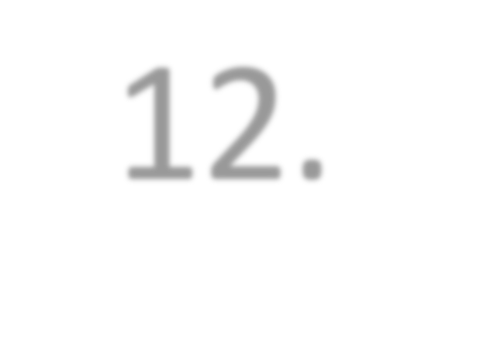


12. Corona Relief Fund: 11.5%
1 Active Bonus -2%- 150-190/-
1 SAB -2%-4500-6000/-
CF -2% HF-1.5%
If 1 Lakh BV in 1st Org & 1 Lakh BV in 2nd Org than 2% If 3 Lakh BV in 1st Org & 3 Lakh BV in 2nd Org (Up to
5,99,999BV)than 2%
So Total 11.5%

Slide 20

Best Strategy:
First 6 Months to 1 Year- Work in 2 Org. Develop the culture for Super Consistency Offer (5000dp purchase before 15th of every month).
When min 50,000BV starts generating in both organization (Auto Mode) than start another 2 Organisation.
Huge income depends on first 2 organization so develop 2 Org. very strongly.

Slide 21



Ok Life Care
Vs Others

Slide 22




ASHOK GUPTA-9555439900

