Slide 1
WOMEN
EMPOWERMENT
By Dr. Vikrant Narwal

Slide 2
Gender Ratio (Women in India)
Total population – 121.06 Cr.
Women population – 586.5 million (48.5%).
Sex Ratio – 943/1000 Men.

Slide 3
Literacy rate (Men/Women)
According to National Statistical Office (NSO):
India’s country-wide female literacy rate = 70.3%.
Male literacy rate is estimated at 84.7%.
India’s average literacy rate stands at 77.7%.

Slide 4
Contribution of Women in various industries:
Corporate sector.
Business.
Agriculture.
Education.
IT Sector.

Slide 5
Challenges:
Gender inequality.
Male dominating culture.
Social barriers.
Harassment in work place.
Lack of employment for educated women.
Difference of wages.
Family pressure.
Work load.
So women need a solution of above these challenges.

Slide 6
DIRECT SELLING
CAN BE A
SOLUTION
FOR THOSE CHALLENGES

Slide 7
Why?
Because:
Time freedom.
Zero investment.
Finance freedom.
Personal freedom.
Self growth.
No specific education base required.

Slide 8
So, OKLIFECARE
Can be a better answer
To all the challenges of
WOMEN EMPOWERMENT

Slide 9
Why OK LIFECARE?
Wide range of product categories:
Women health.
Child health.
Personal care.
Kitchen care.
Daily usage.
Simple business plan.
Affordable price.
World class packaging & quality.
Education system (Networkking).

Slide 10
List of Product Categories:
Women Health/Personal Care:
Women power.
Pink 18+.
Fighter 40+.
Beauty fuel.
Shatavari + jeera.
Leucorest.
Multivitamin facial kit.
De-tan Bright facial kit.
Lassie intimate wash.
Happy lady sanitary pads.
Hair removal cream.
BB cream.
British Rose toner.

Slide 11
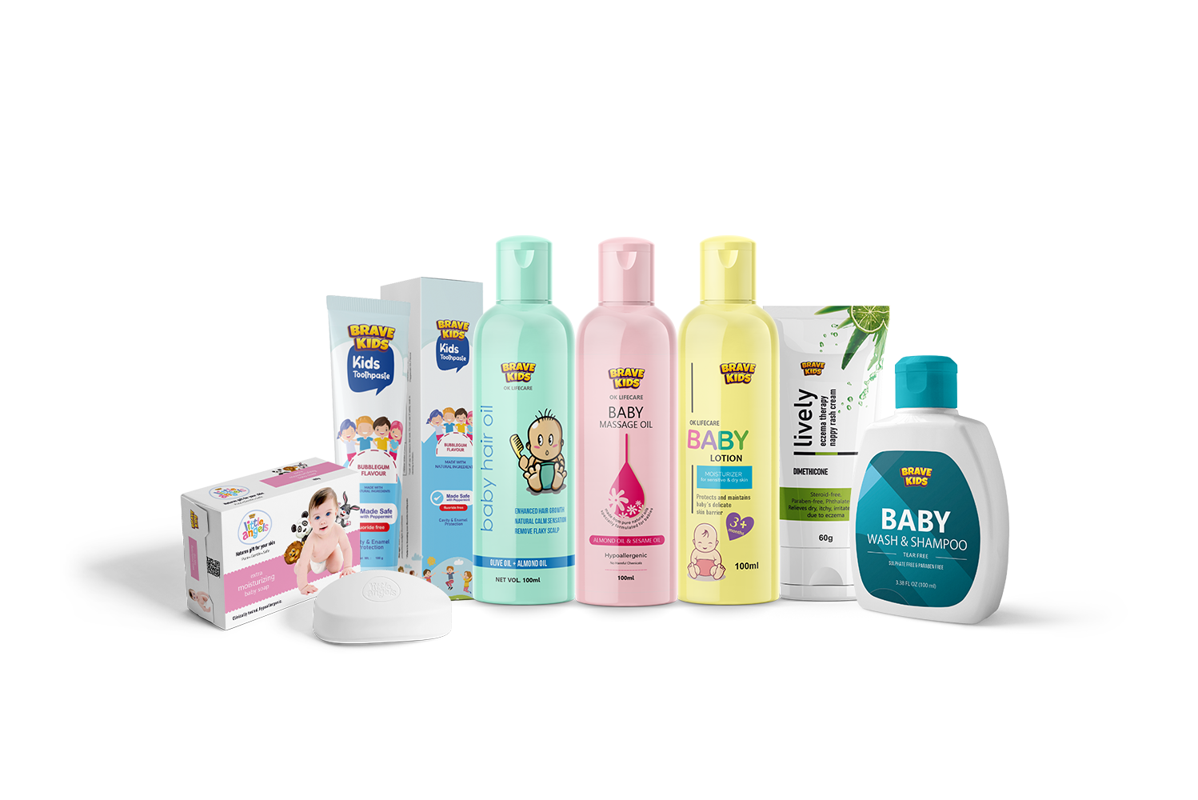
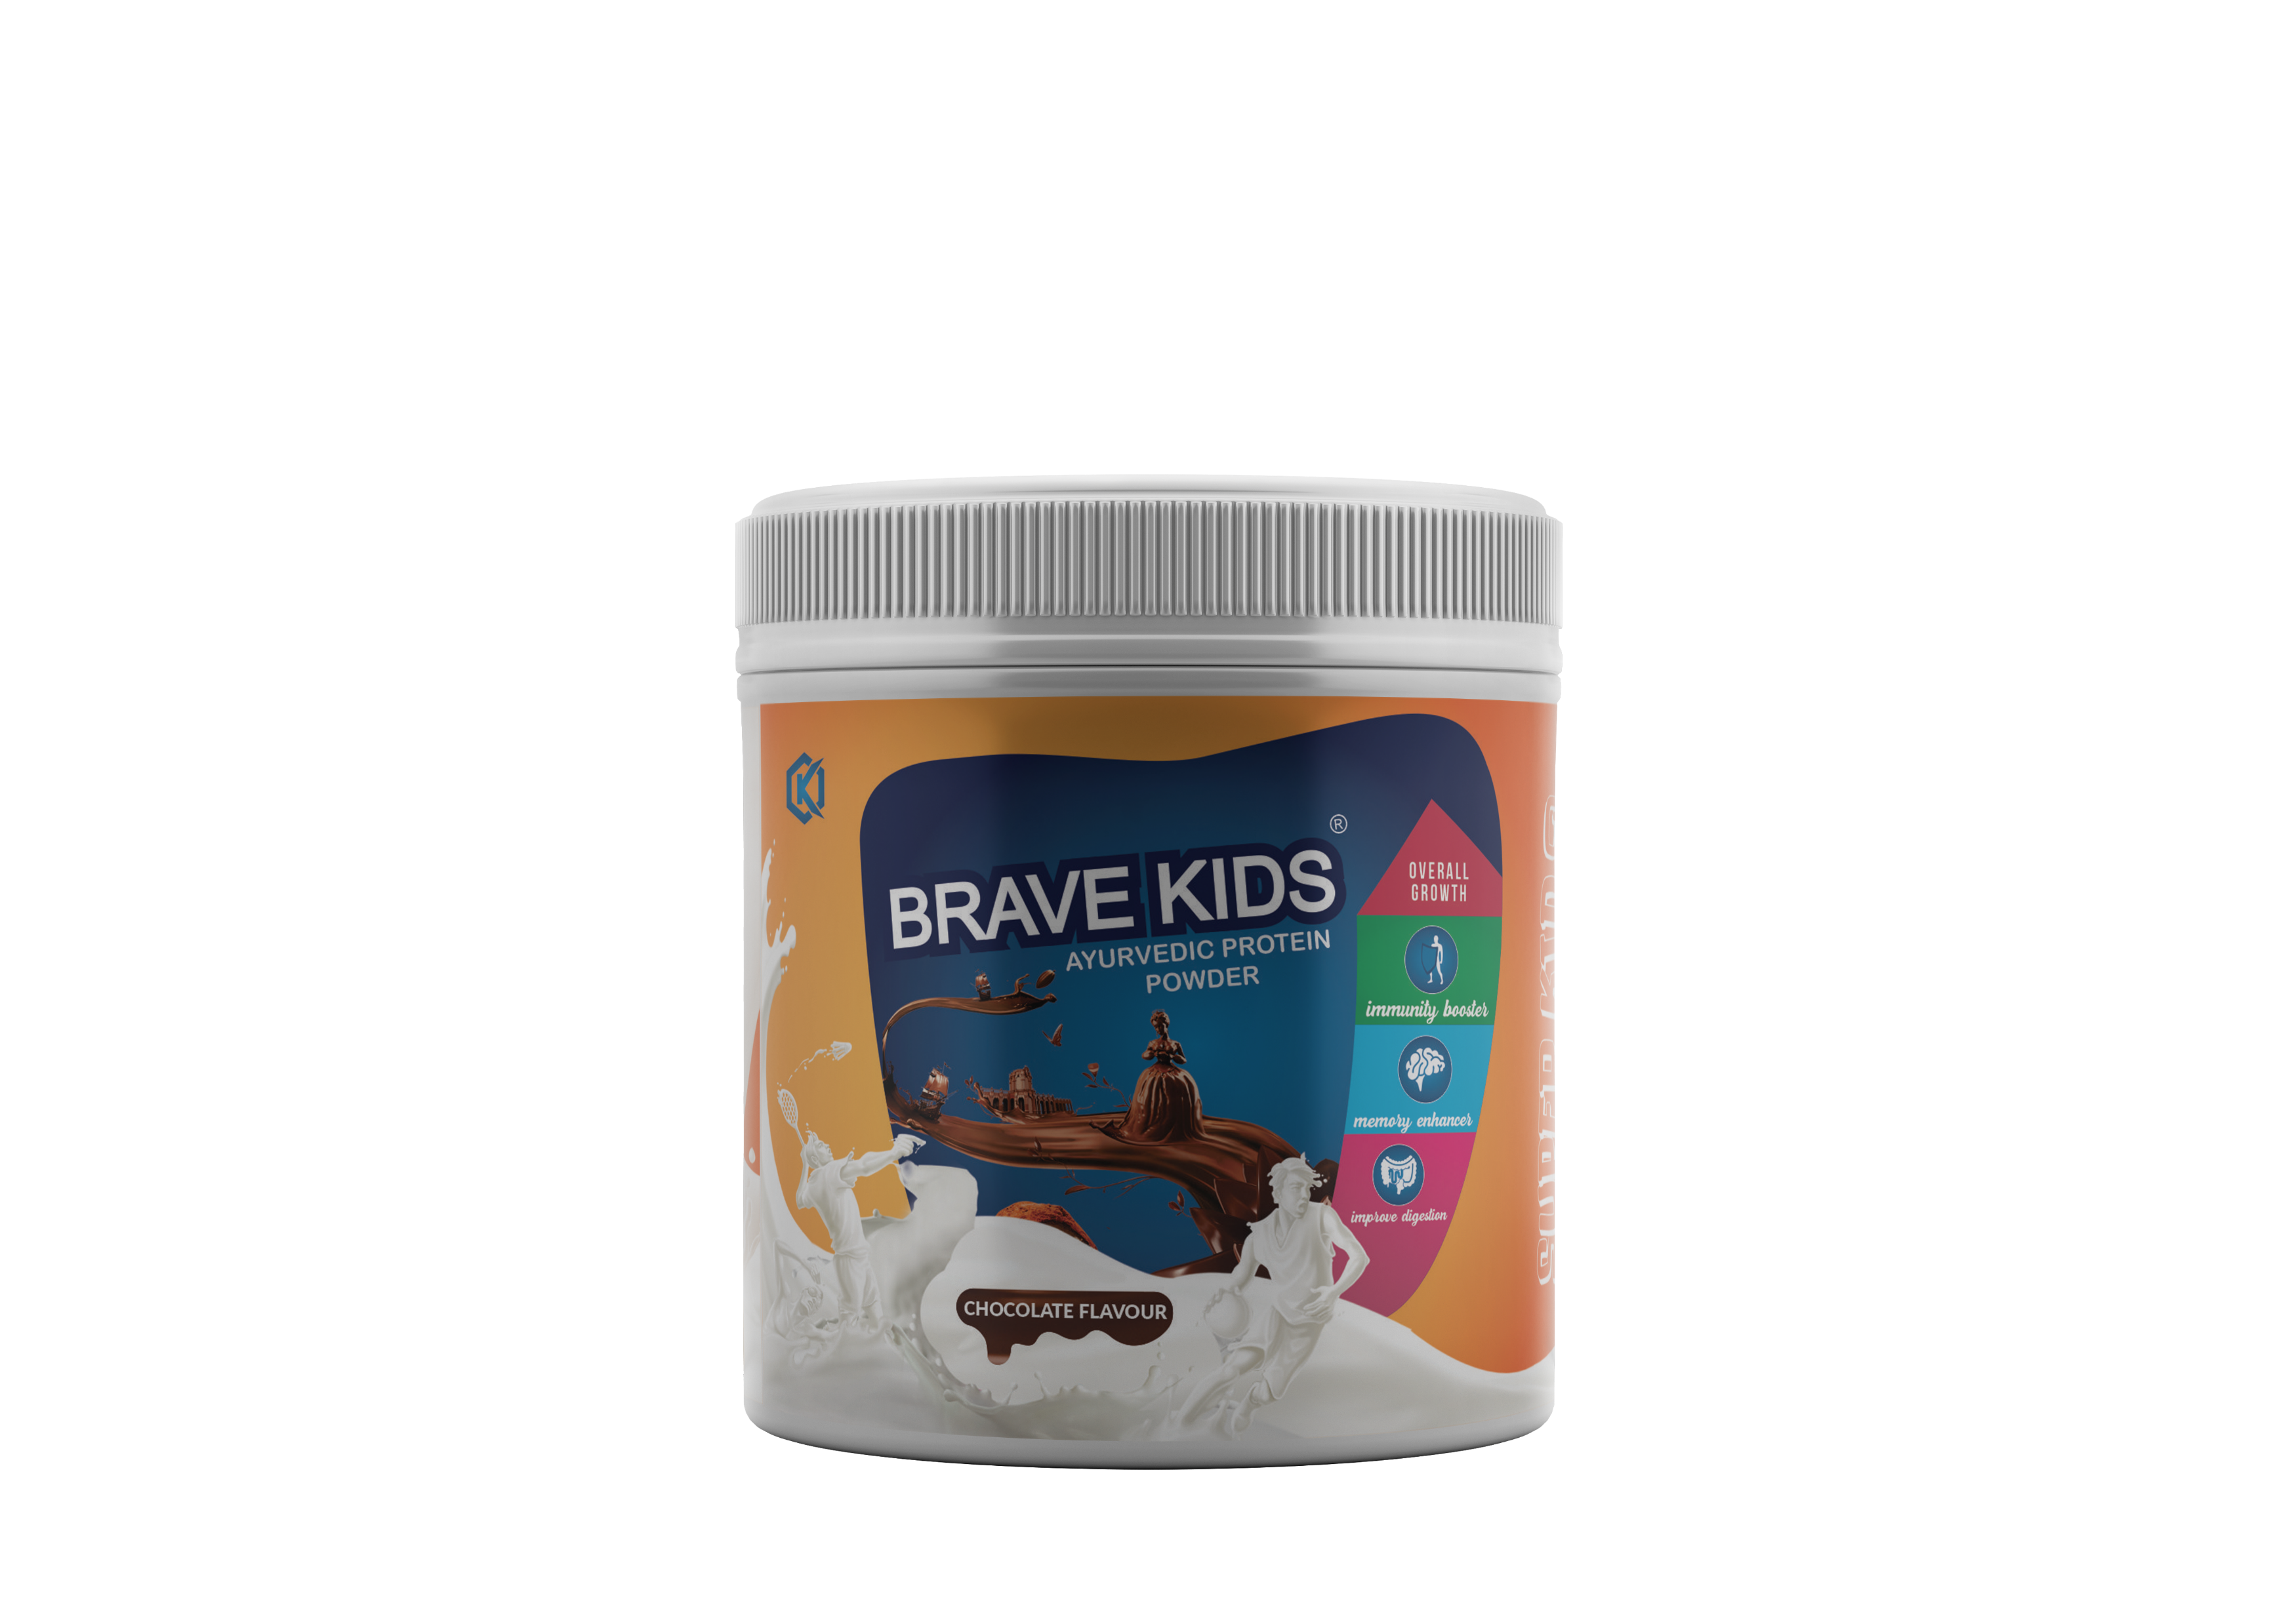
List of Product Categories:
Child Health
Brave Kids Protein powder.
Brave Kids Toothpaste.
Brave Kids Lotion.
Brave Kids Massage cream.
Brave Kids Hair oil.
Brave Kids Soap.
Brave Kids Bay Wash & Shampoo.
Brave Kids Nappy rash cream.

Slide 12
List of Product Categories:
Kitchen Care
Core Spices.
Indian Tea.
Rice Bran Oil.
Super Swab Dish Bar.

Slide 13
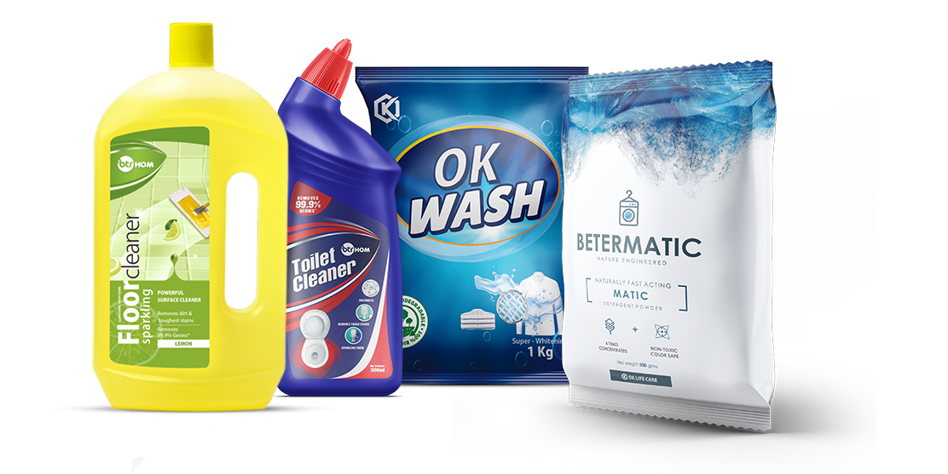
List of Product Categories:
Daily Usage:
BTR HOM Toilet Cleaner.
BTR HOM Floor Cleaner.
Betermatic Detergent.
OK Wash.

Slide 14
WOMEN
HEALTH

Slide 15
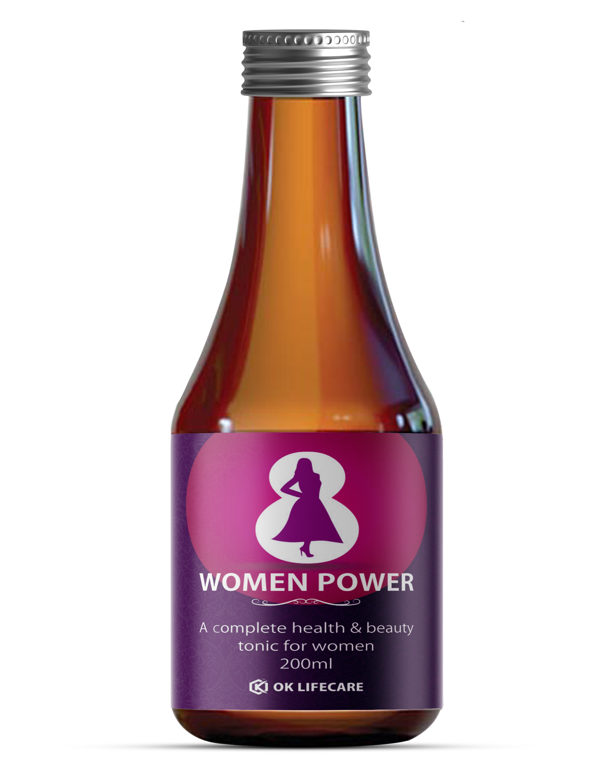
WOMEN POWER
A complete women health & beauty tonic.
Ayurvedic combination of useful herbs.
Natural blood purifier.
Effective for glowing skin & beauty.
Brings a natural balance to female hormones.
Antioxidants & Boosts immunity.
Restores the hair health.
Reduces fatigue.
MRP: ₹ 300
DP: ₹ 240
BV: 120
Retail Profit: ₹ 60
Quantity : 200ml
*Recommended Dosage : 10-15 ml twice daily, after meal or as directed by Health Practitioner.

Slide 16
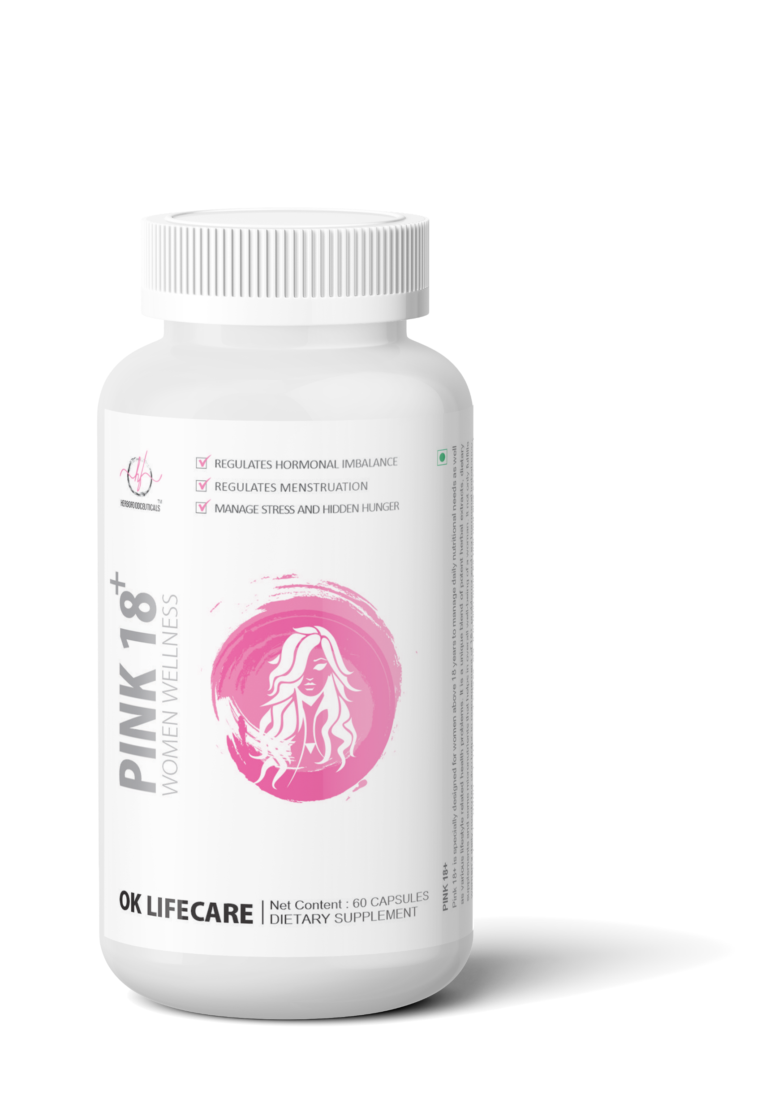
PINK 18+
Helps in premenstrual symptoms.
Combination of herbs and essential nutrients.
Helps in PCOD.
Regulated hormonal imbalance.
Restores the hair health.
Regulates menstruation.
Manages mood swings.
Manages stress & hidden hunger.
MRP: ₹ 875
DP: ₹ 699
BV: 280
Retail Profit: ₹ 176
Quantity : 60 Caps.
*Recommended Dosage : 1-2 Capsules twice daily, after meal or as directed by Health Practitioner.

Slide 17
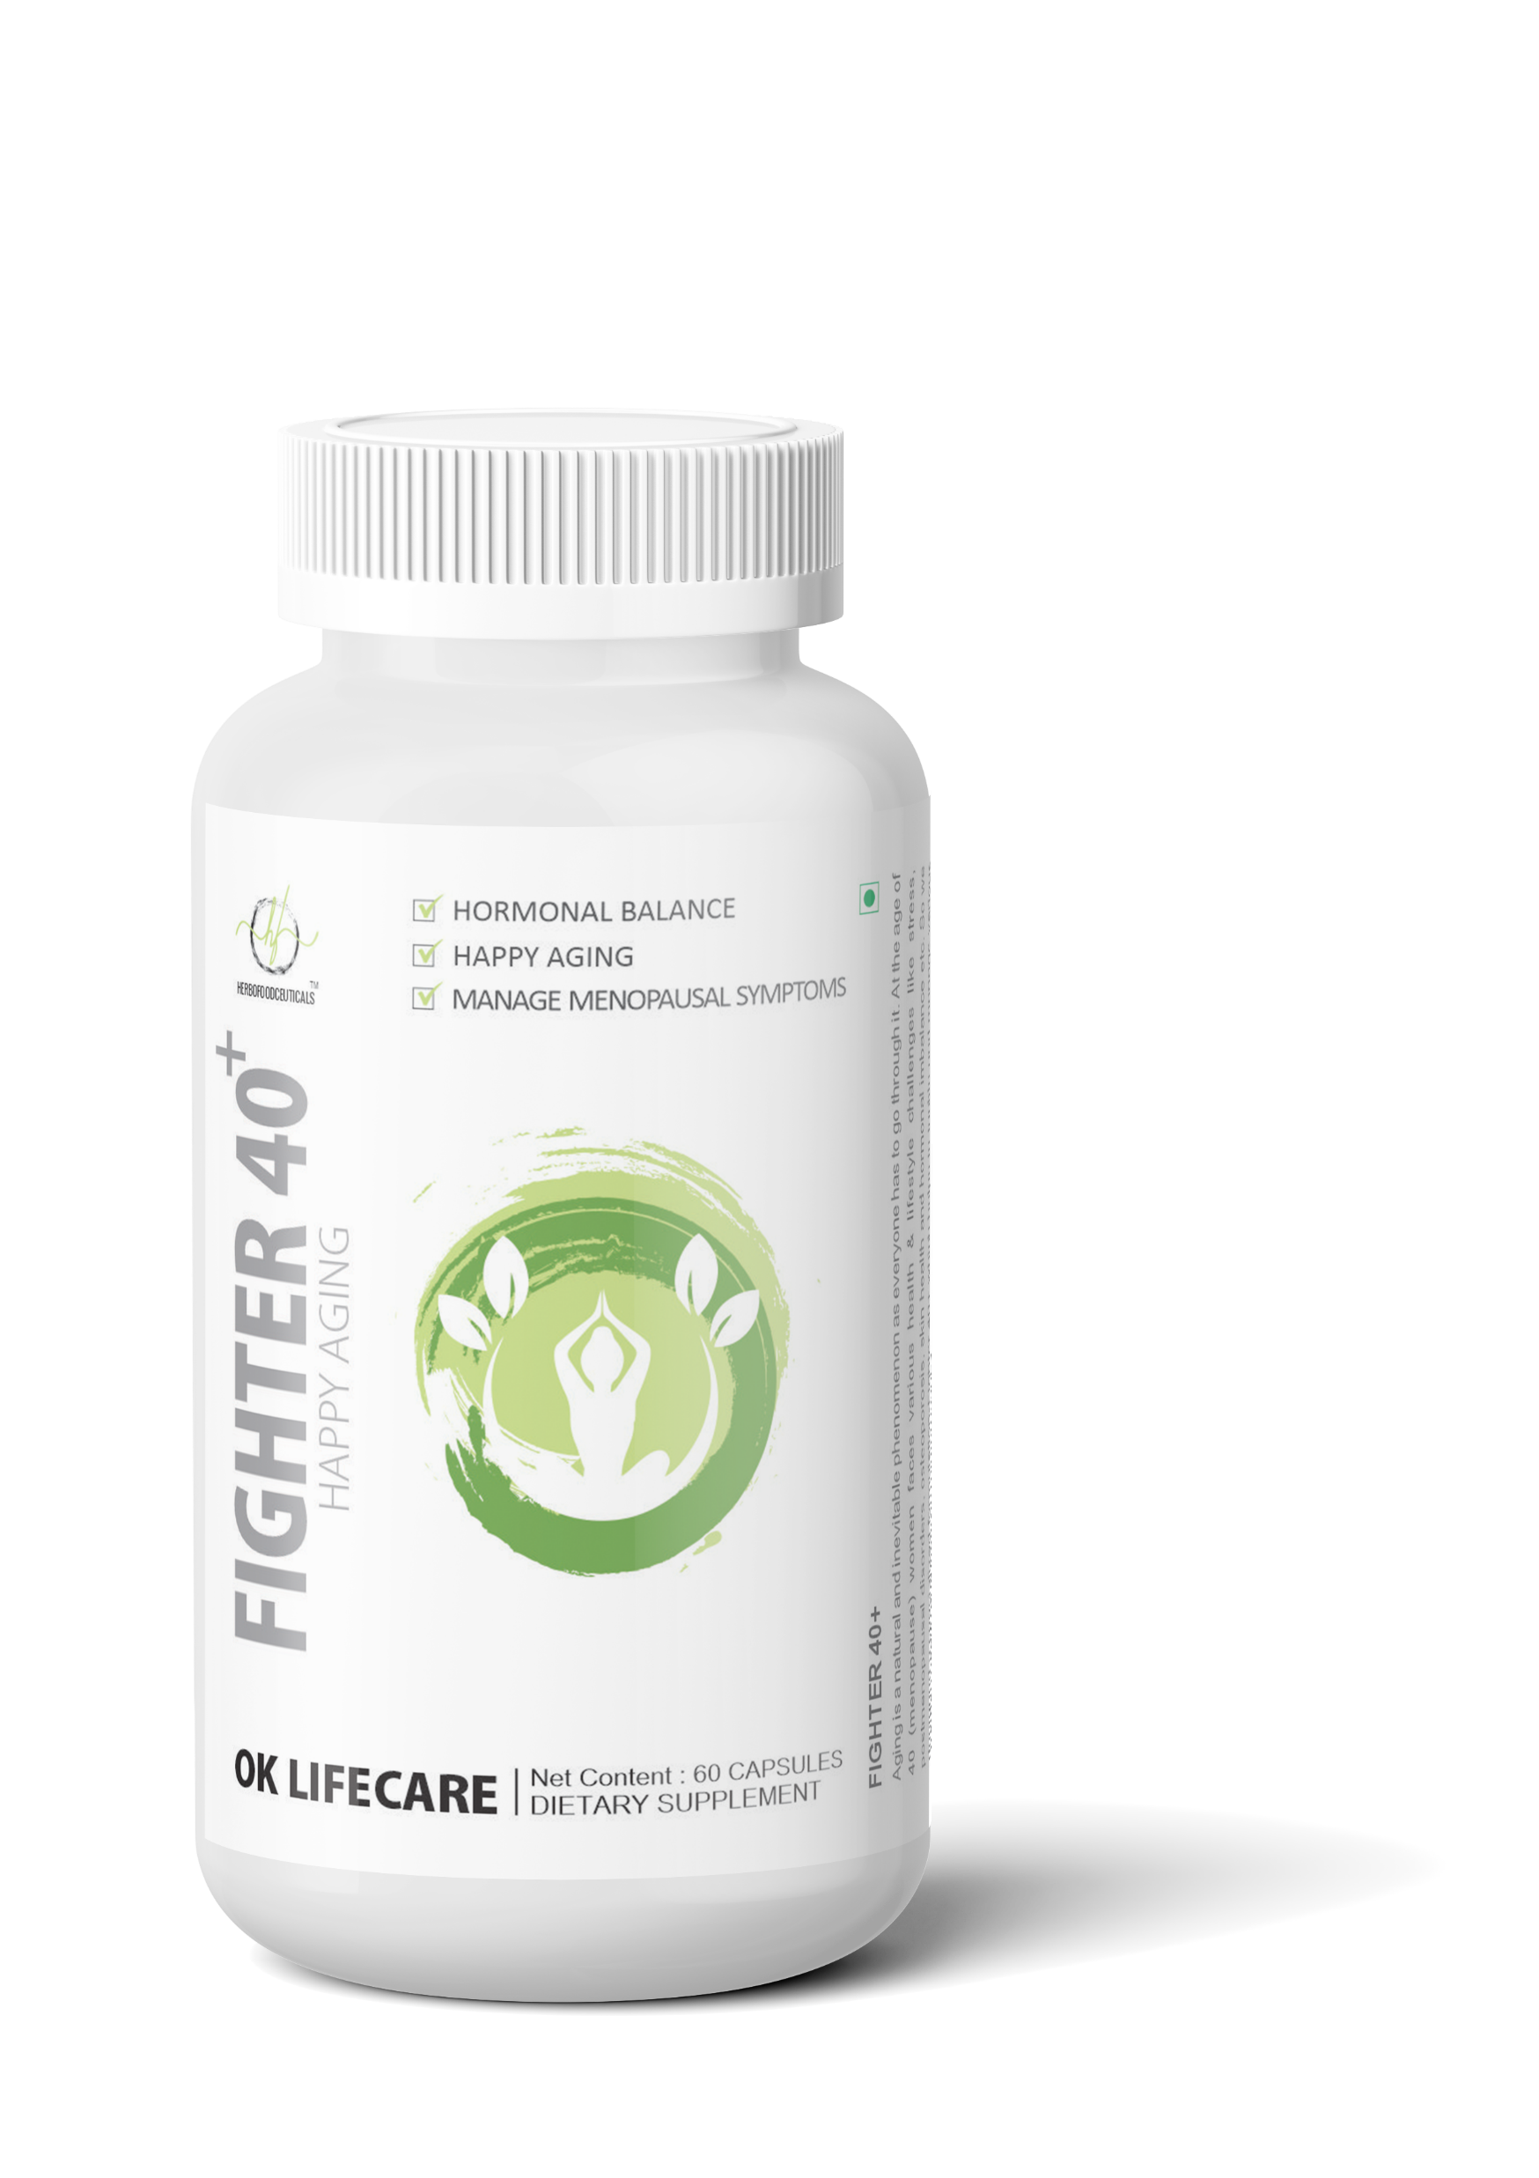
FIGHTER 40+
Manages sleep cycle.
Combination of herbs and essential nutrients.
Hormonal Balance.
UTI management.
Manages pre/post menopausal symptoms.
Reduces the chances of osteoporosis.
Manages mood swings & sleep cycle.
Anti-aging effect.
MRP: ₹ 875
DP: ₹ 699
BV: 280
Retail Profit: ₹ 176
Quantity : 60 Caps.
*Recommended Dosage : 1-2 Capsules twice daily, after meal or as directed by Health Practitioner.

Slide 18
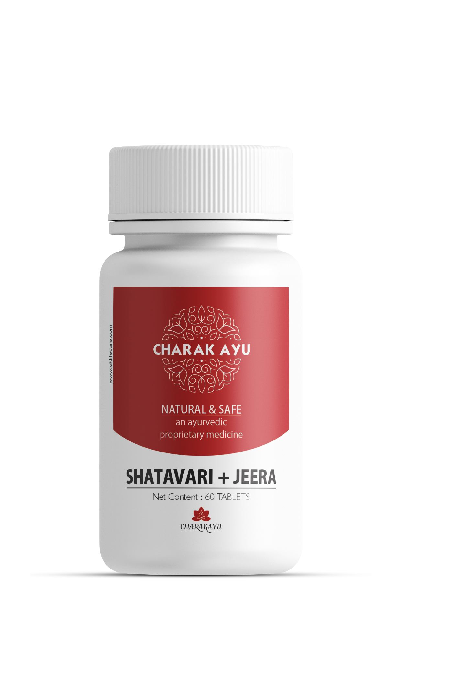
SHATAVARI + JEERA
Relieves menstrual pain.
Used as a female reproductive tonic.
Both herbs have rejuvenating properties.
Supports lactation.
Overcome fatigue.
Regulates hormonal imbalance.
Promotes physical and mental health.
Improves fertility.
MRP: ₹ 199
DP: ₹ 159
BV: 48
Retail Profit: ₹ 40
Quantity : 60 Tablets
*Recommended Dosage : 1-2 Capsules twice daily, after meal or as directed by Health Practitioner.

Slide 19
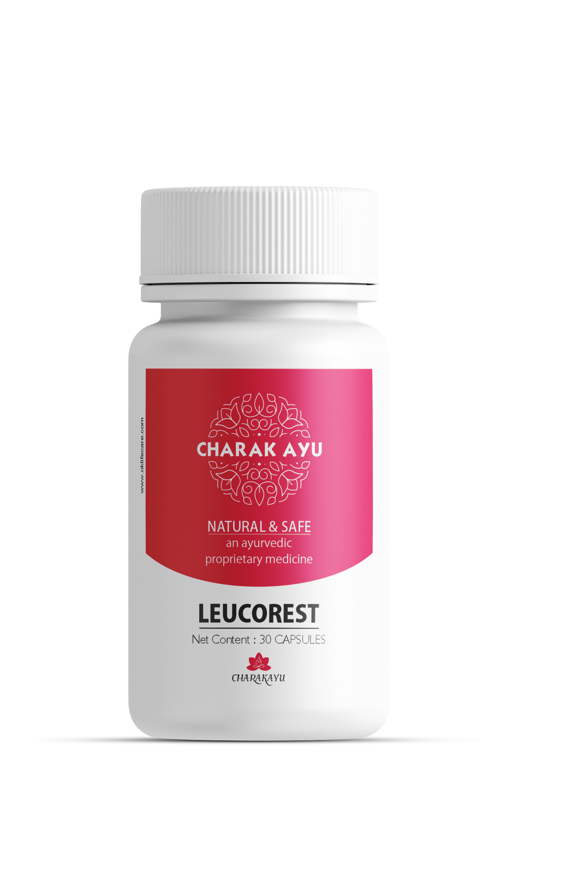
LEUCOREST
Formulation for Leucorrhoea management.
Relieves back pain & weakness.
Anti-microbial and anti-inflammatory properties.
Manages vaginal infection.
Stimulates immune system.
Helpful in heavy periods.
Reduce muscle weakness.
Helps in decreasing pelvic congestion & discharge.
MRP: ₹ 400
DP: ₹ 300
BV: 150
Retail Profit: ₹ 200
Quantity : 60 Tablets
*Recommended Dosage : 1-2 Capsules twice daily, after meal or as directed by Health Practitioner.

Slide 20
Contribution of Women in Indian Direct Selling:
Women contributes 53% of entrepreneurs engaged in the $1.5 billion (Rs. 98.5 billion) direct selling industry in India.
The Indian direct selling industry provided entrepreneurship opportunities to 5.1 million people in 2017 of which 2.7 million were women.
This reflects a healthy trend of growth in contribution to the sector by women entrepreneurs at a time when India is witnessing a rise in unemployment rates.

Slide 21
Contribution of Women in International Direct Selling:
The World Federation of Direct Selling Associations (WFDSA) reported that in 2020, a staggering 74.4% of direct selling representatives are women.
More women around the world are making the decision to turn direct sales into an opportunity for personal success.

Slide 22
Conclusion
Direct selling has the potential to support the women empowerment.
OK LIFECARE enables women to balance their professional and personal lives, while contribution to the household income.
As they excel, women entrepreneurs are also building communities of empowered women by generating income opportunities for others.
So, Be Empowered | EK KADAM AAGE!

Slide 23
THANK
YOU!

